Slide 1
Analyzing New York Boroughs To Determine Business Venue Locations
By
Kaung myat kyaw

Slide 2
Background
New York also is among the leading financial industry center in America
New York has five neighborhood districts also known as Boroughs, from each borough contains 59 official neighborhoods that are recognized by the city
Determine the neighborhood that returns the highest business venue to recommend the business categories for investors

Slide 3
Data Acquisition and Cleaning
Data Scraping from Opan Data City of New York using Beautiful Soup python library
Total number of restaurants in Manhattan is 925 and total number of Asian restaurants in Manhattan is 16
Total number of restaurants in Brooklyn is 622 and total number of Asian restaurants in Brooklyn is 12
Duplicate Postal code with same Borough and Neighborhood were merged
I used https://foursquare.com/ to get the most common venues of given Borough of New York City.

Slide 4
Methodology
Use the longitude and latitude to get venue information within 500 m of each neighborhood
Explore venue data and cluster neighborhood
Obtain detailed listing information of Borough in New York City, calculated the average price per bed per night for each neighborhood
Merged the above data to get a consolidated dataset.
Sorted the neighborhood by average price and number of venues.

Slide 5
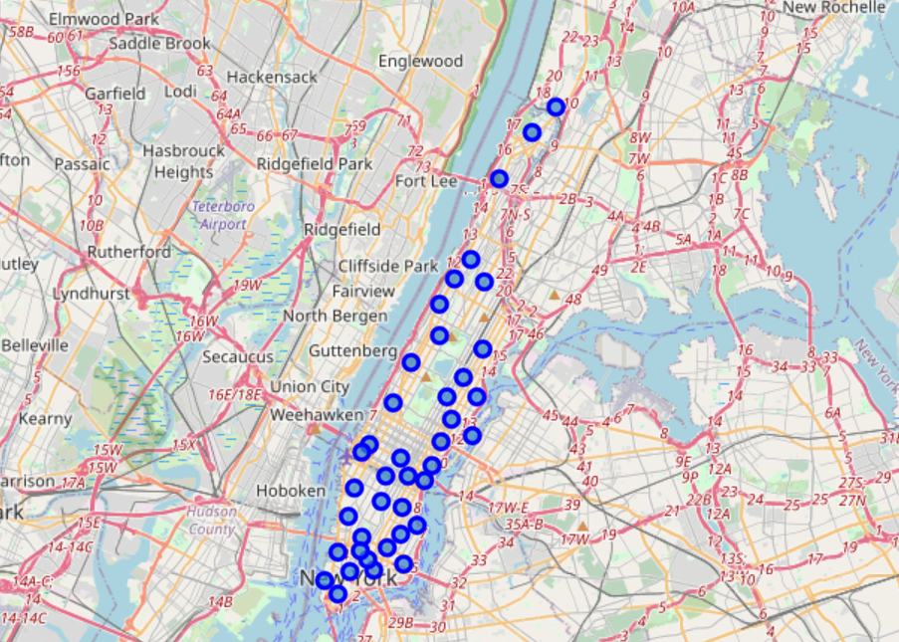
Folium Map - Manhattan
Folium used to display the location of the borough and their neighborhood on the map
There are 3252 venues in Manhattan.
Total number of restaurants in Manhattan is 925
Total number of Asian restaurants in Manhattan is 16

Slide 6
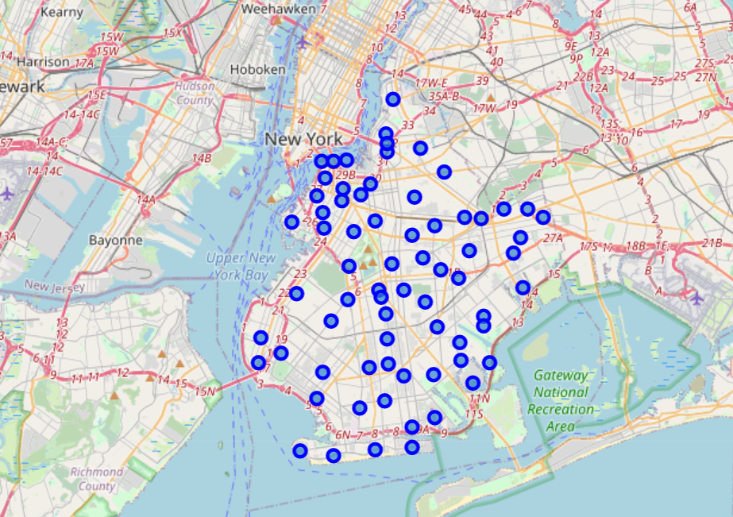
Folium Map - Brooklyn
Folium used to display the location of the borough and their neighborhood on the map
There are 2732 venues in Brooklyn.
Total number of restaurants in Brooklyn is 622
Total number of Asian restaurants in Brooklyn is 12

Slide 7
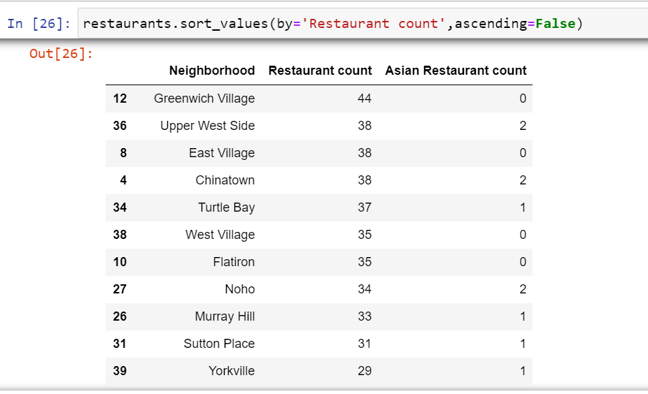
Result - Manhattan
Categories of business venues returned
Manhattan
Returned 3252 venues

Slide 8
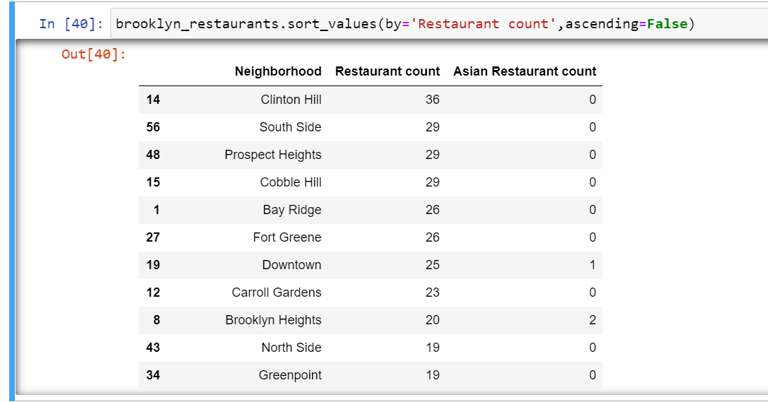
Result - Brooklyn
Categories of business venues returned
Brooklyn
Returned 2732 venues

Slide 9
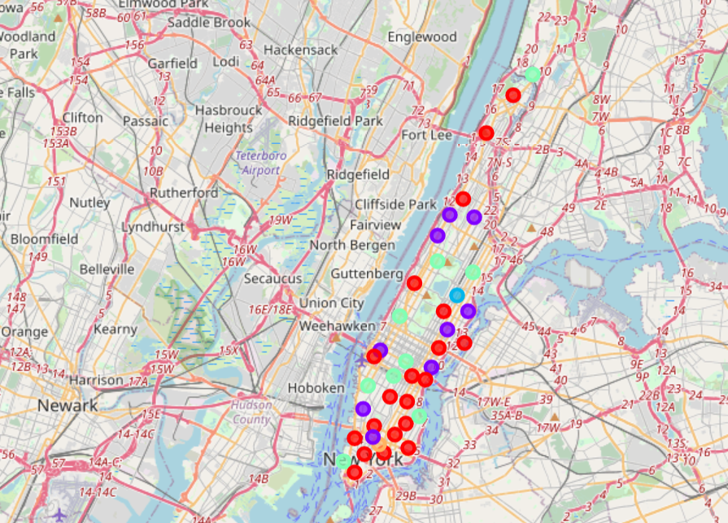
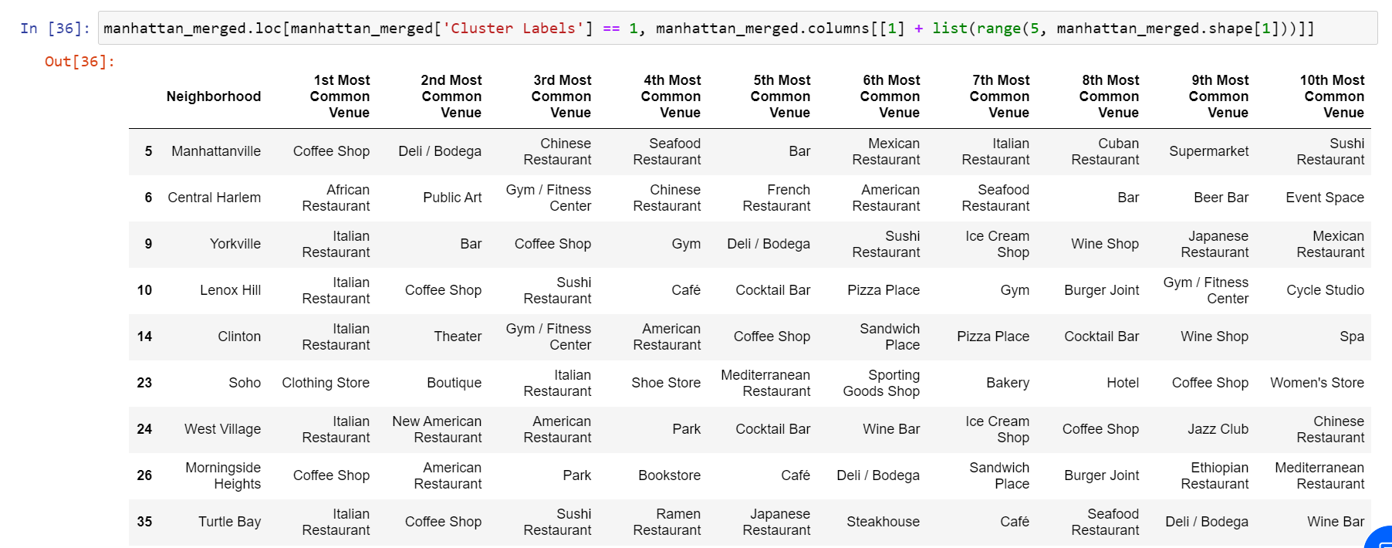
K-Means Clusters - Manhattan
First five most common venue
Cluster label mostly in the first cluster
Downtown Toronto Most Common Venue

Slide 10
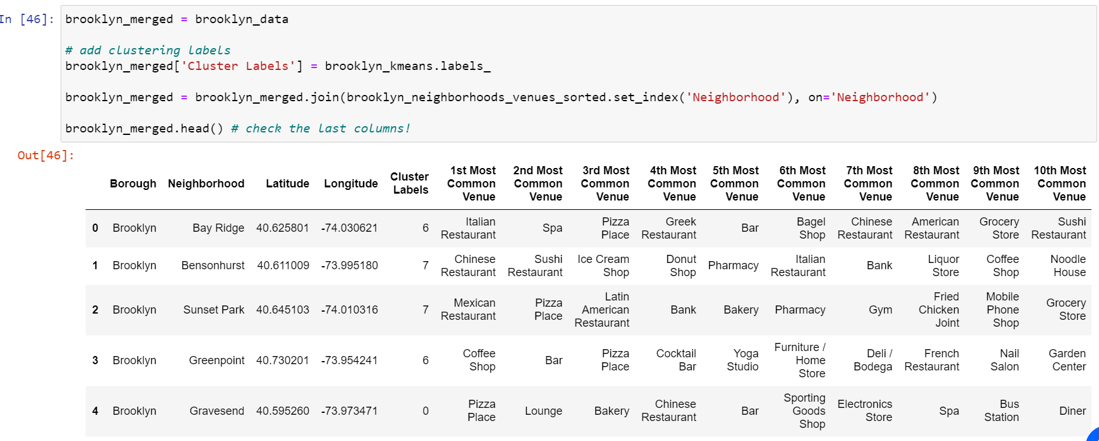
K-Means Clusters - Brooklyn
First five most common venue
Cluster label mostly in the first cluster

Slide 11
Discussion
The analysis can give the business investor on what type of business and location where businesses are less competitive and fast-growing
I used K-Means algorithm, setting the optimum k value to 5, considering 17 Downtown New York City Neighborhoods

Slide 12
Conclusion & Future Directions
Prediction model are not used so I could not make any final inferences which is the best location but suggested to have business in the neighborhood that return most venues.
Regression models can be used to analyze the average housing price differences in the future
For more analysis insight, the cost of housing can be investigated according to their postal code for new residents or immigrants.

